Slide 1
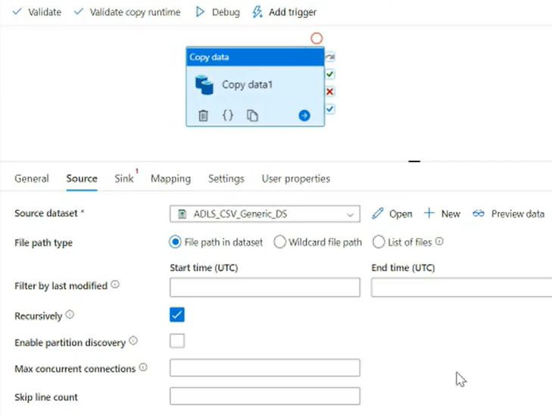
Sub folders also get transfer

